Slide 1
Plant Viruses
&
Transmission of Plant Viruses
Dr. Sonal Mishra

Slide 2
Plant viruses
More than 1000 different viruses cause plant diseases.
Including diseases of citrus trees, cocoa trees, rice, barely, tobacco, turnips, cauliflower, potatoes, tomatoes and many fruits, vegetables, trees and grains.
These diseases result in huge economic losses.
Plant viruses are usually transmitted via insects (e.g. aphids, leaf hoppers, whiteflies), mites, nematodes (i.e. round worms), infected seeds, cuttings and tubers, and contaminated tools (e.g. hoes, clippers and saws).
Notes:
Aphids المن / Mites العث /Hoe معول

Slide 3


TRANSMISSION OF PLANT VIRUSES

Slide 4




Cell-to-Cell Movement of Plant Viruses
Plant viruses move cell-to-cell slowly through plasmodesmata
Most plant viruses move cell-to-cell as complexes of non-structural protein and genomic RNA
The viral protein that facilitates movement is called the “movement protein” (MP)
Coat protein is often dispensable for cell-to-cell movement

Slide 5




Cell-to-Cell Movement of Plant Viruses
Several unrelated lineages of MP proteins have been described
MPs act as host range determinants
MP alone causes expansion of normally constricted plasmodesmata pores; MPs then traffic through rapidly
MPs are homologs of proteins that naturally traffic mRNAs between cells
MPs may act as suppressors of gene silencing

Slide 6
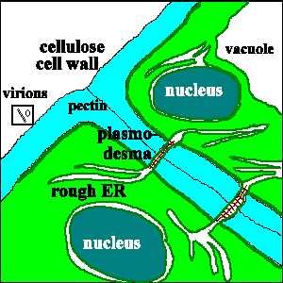
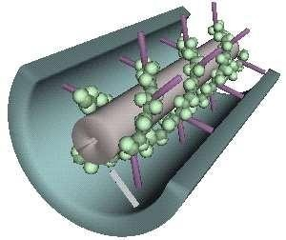
Plasmodesmata

Slide 7


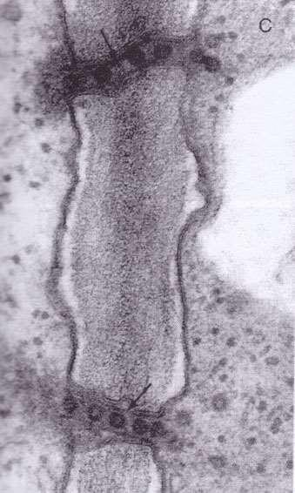
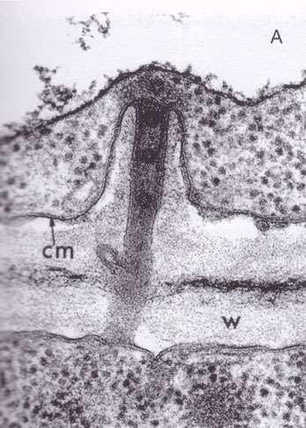
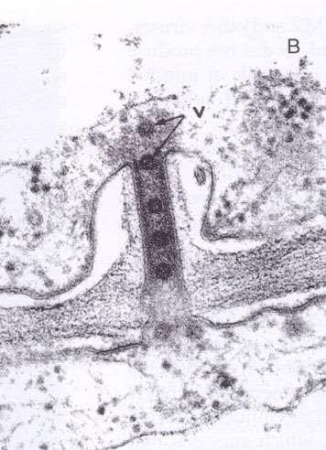
SOME PLANT VIRUSES RADICALLY MODIFY PLASMODESMATA, ALLOWING FOR CELL TO CELL MOVEMENT AS WHOLE PARTICLES.

Slide 8
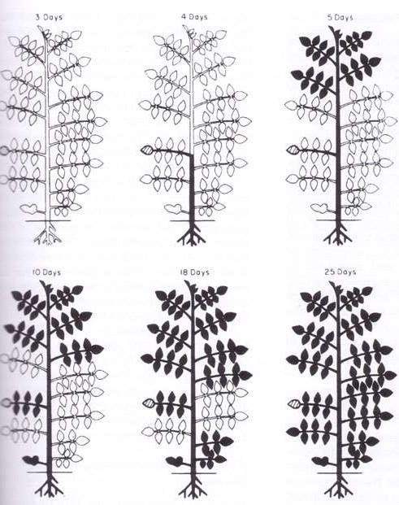

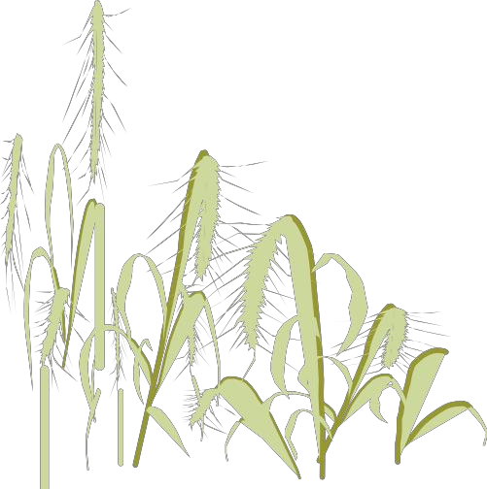
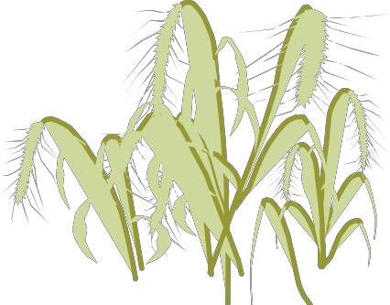
Systemic spread of plant viruses is primarily through vascular tissue, especially phloem

Slide 9

Plant Virus Transmission
Generally, viruses must enter plant through healable wounds - they do not enter through natural openings (no receptors)
Insect vectors are most important means of natural spread
Type of transmission or vector relationship determines epidemiology
Seed transmission is relatively common, but specific for virus and plant

Slide 10



TYPES OF PLANT VIRUS TRANSMISSION
HORIZONTAL TRANSMISSION
Horizontal transmission is by vectors, human pruning shears and tools, and other direct, external contamination.
VERTICAL TRANSMISSION
Vertical transmission occurs when a plant gets it from its parent plant. Either through asexual propagation (cuttings) or in sexual reproduction via infected seeds.

Slide 11



TRANSMISSION METHODS
Non-Insect transmission:
Sap inoculation/ Mechanical: TMV, PVY Seed: BCMV,
Fungi: Olpidium brassicae- TNV
Vegetative & graft transmission: PVY, PLRV, Fruit viruses Nematodes: Xiphinema index: Grapevine fan leaf virus Dodder: CMV, TRV Insect Transmission: PVY, CMV, BGMV
Insect Transmission: PVY, CMV, BGMV

Slide 12

Mechanical transmission
  Deliberate – rub-inoculation
  Field – farm tools, etc.
  Greenhouse – cutting tools, plant handling
  Some viruses transmitted only by mechanical means, others cannot be transmitted mechanically
  Occurs when plant come in contact with other plant and leaves rub together
By the action of humans
Mechanical transmission involves the introduction of infective virus or biologically active virus into a suitable site in the living cells through wounds or abrasions in the plant surface
This method is generally used for experimental purposes under laboratory conditions- also known as Sap inoculation

Slide 13

METHODS
Leaf rub
Cotton swab
Pinprick
Microinjection
Steps:
Sap extraction
Extraction medium
Use of additives
Choice of suitable host: most common are Nicotiana spp., Chenopodium spp., Cucumis sativus, Gomphrena, Datura spp, Phaseolus vulgaris

Slide 14






MECHANICAL TRANSMISSION AFFECTED BY:
Source & preparation of Inoculum
Leaf- most common source
Have high conc of virus
Roots: TNV
Fruits, flower & pollens
Symptoms expression
Virus concentration
Extraction medium (Water & Buffer)
Buffers (Po4 , borate, citrate, Tris-HCL)
Retain infectivity
Stability
Intact virus
Avoid aggregation
Buffer pH: 7-8 pH

Slide 15

Metal ions and ionic strength
Some viruses require divalent metal ions (Ca+ or Mg2+) for retention of infectivity and structural integrity
pH, chelating agents and ionic strength help in virus stabilization in extracted sap.
Chelating agents eg. EDTA
Help in removal of host ribosomes; avoid virus aggregation; prevent oxidantion of polyphenols
Reducing agents: ( Thioglycolic acid, Ascorbic acid, cysteine hydrichlooride sodium sulphite, 2-mercaptaethanol)
These prevent oxidation of plant extract and preserve infectivity of the virus

Slide 16
Substances protecting against phenolics:
cysteine hydrichlooride, sodium sulphite: prevent action of phenol oxidases.
PVP-polyvinyl pyrrolidine, PEG: reduces binding of virus with phenols
Additives that removes plant protein and ribosomes
Mg bentonite- reduces contamination of virus extract with nucleases and ribosomes (mainly !9s protein)
Charcoal: adsorb host pigments
Na EDTA @ 0.01M ph 7.4
Enzymes:
eg. Pectinase is used to degrade mucilage in sap of cocoa leaves prior to precipitation of CSSC, Trypsin -TuMv

Slide 17


VEGETATIVE AND GRAFT TRANSMISSION
Aim is to establish organic union between the cut surfaces of tissues of two different hosts
Shoot-Scion
Root bearing portion - stock
If either stock or scion is infected the virus usually moves to the healthy portion and express symptoms
A pre-requisite for successful graft transmission is the perfect union of the cambium layers of the stock and the scion.
Eg. CTV, Apple mosaic virus etc.

Slide 18

DODDER TRANSMISSION
Cuscuta spp.(Benett (1940)
About 20 spp.
C. campestris & C. subinclusa are common
E.g. Phytoplasma
Vegetative propagations
Cuttings
Tubers
Corms etc.
Bulbs

Slide 19

Plant Virus Transmission by Vectors
TRANSMISSION BY VECTORS: GENERAL
  Arthropods most important
  Most by insects with sucking mouthparts
    Aphids most important, and most studied
    Leafhoppers next most important
  Some by insects with biting mouthparts
  Nematodes are important vectors
  “Fungi” (protists) may transmit soilborne viruses
  Life cycle of vector and virus/vector relationships determine virus epidemiology
  A given virus species generally has only a single type of vector

Slide 20
Insect transmission (vectors)
  Aphids most important
  Leafhoppers
  Whiteflies
  Thrips
  Mealybugs
  Beetles
  Mites (Arachnidae)
  Ants, grasshoppers, etc. – mechanical
  Bees, other pollinators – pollen transmission

Slide 21








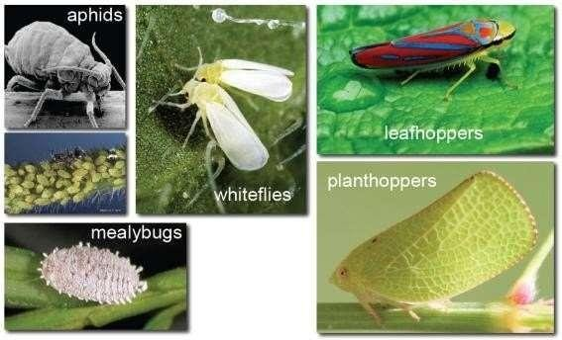
Phylum Arthropoda, Class Insecta, Order Hemiptera

Slide 22





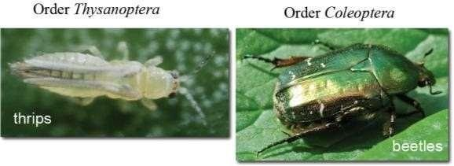
Phylum Arthropoda, Class Insecta

Slide 23







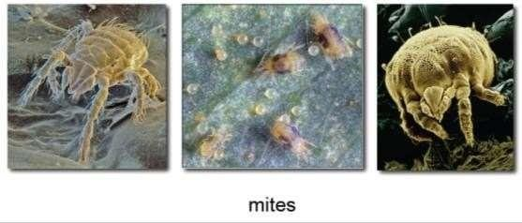
Phylum Arthropoda, Class Arachnida, Order Acariformes

Slide 24








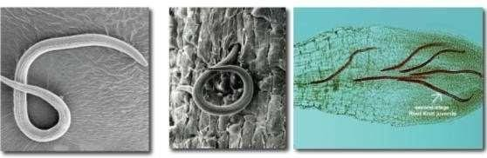
Phylum Nematoda, Class Secernentea, Order Tylenchida

Slide 25

Types of vector relationships
Terms apply mainly, but not exclusively, to aphid transmission
Non-persistent transmission
ovirus acquired quickly, retained short period (hours), transmitted quickly
o“stylet-borne” transmission
ovirus acquired and transmitted during exploratory probes to epidermis

Slide 26

PERSISTENT TRANSMISSION
  virus acquired slowly, retained long period (weeks), transmitted slowly
  circulative or propagative transmission
  virus acquired and transmitted during feeding probes to phloem
Virus persist in their vector for >100 hrs and in some cases for whole life of vector
Virus multiply and circulate in vector body
Latent period is present
Moulting has no effect of virus
After virus uptake-- alimentary canal gut wall cirulate In the body fluid (Haemolymph)
glands causing contamination of salive
Also called as
Circulative
Circulative propagative
Trans-ovarial transmission
E.g. PLRV, RDV, PYDV, BYDV
salivary
transmission

Slide 27
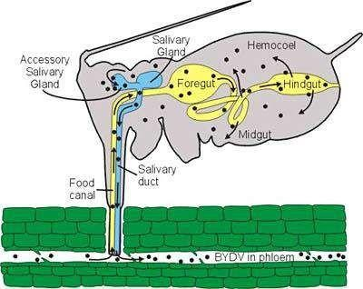

Slide 28
CIRCULATIVE TRANSMISSION: (syn. persistent transmission) virus transmission characterized by a long period of acquisition of the virus by a vector (typically an insect), a latent period of several hours before the vector is able to transmit the virus, and retention of the virus by the vector for a long period, usually several days; the virus circulates in the body of the vector (aphid vector feeding on a plant host showing the internal route of the viruses that cause barley yellow dwarf)

Slide 29

Semi-persistent transmission
o virus acquired fairly quickly, retained moderate period (days), transmitted fairly quickly
o virus acquired and transmitted during exploratory probes
Virus persist in its vector for 10-100 hrs.
Acquired from phloem region with long feeding
No latent period
Do not circulate and multiply in its vector
Infectivity lost in moulting
Particles accumulate at special sites
High vector specificity
E.g. CTV, CaMV, BYV

Slide 30
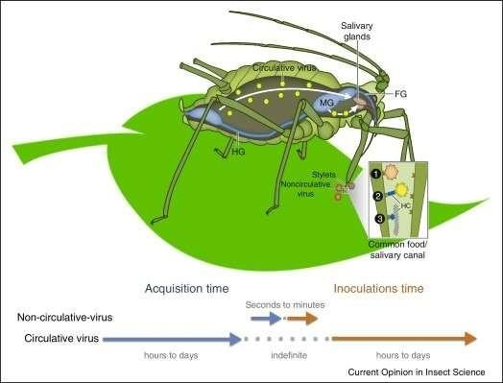

Slide 31

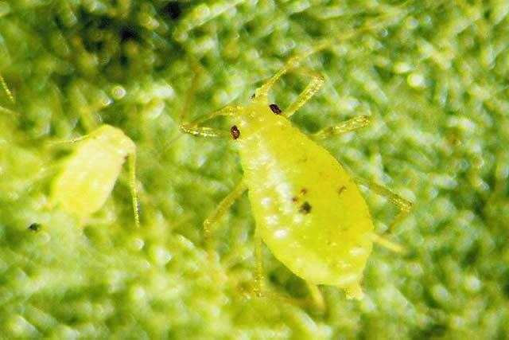
EXAMPLE OF INSECT TRANSMISSION
Myzus persicae: most efficient among all; transmit >100 viruses

Slide 32

CONCEPT OF HELPER VIRUS
These are the viruses transmitted by aphid vectors under certain conditions
A aphid transmit can transmit the virus only if the source plant is infected by second virus.
So it is a dependent virus and second virus is referred as the helper virus
virus

Slide 33

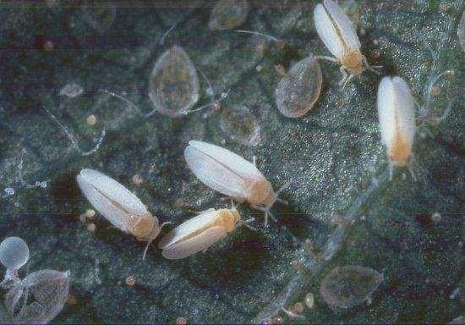
WHITE FLY
transmit rugose diseases causing mosaic to leaf distortions
Bemisia tabaci
Virus vector relationship moslty circulative; semi persistent to persistent
Females efficient in transmission
LP-few hrs.
Phloem
Virus not transmitted by sap
TLCV, MYMV, ClCV, BYVMV, BGMV, SYMV

Slide 34

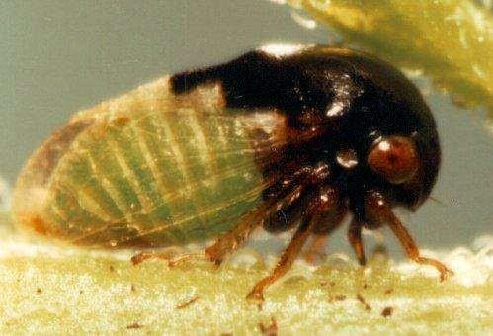
LEAF HOPPERS/ PLANT HOPPERS
Semi & persistent transmission
Propagative viruses
Causes mainly yellows, leaf rolling
Phloem cells
Leafhopper:
RDV: Nephotetix cincticeps
Rice tungro: N. impicticeps
Transovarial transmission: RDV
Plant hopper: maize mosaic: Pergrinus maidis
Tree hopper:
Tomato pseudo curly top: Micrutalis malleifera
Micrutalis malleifera, the treehopper vector of Tomato pseudo-curly top virus

Slide 35
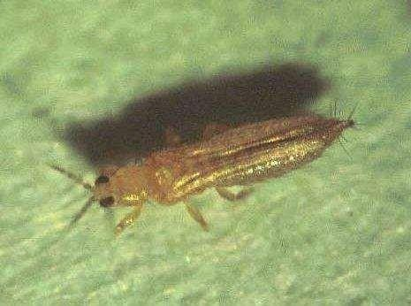
Thrips: transmit viruses in the genus Tospovirus.
Frankinella occidentalis

Slide 36

BEETLE TRANSMISSION
Acq. Feeding : upto 24 hrs
Persistent transmission
Cowpea mosaic virus: Ceratoma trifurcata
Turnip yellow mosaic: Phyllotreta sp.

Slide 37

NEMATODE TRANSISSION
Nematodes as vectors of plant viruses initiated research in Nematology and Virology Hewitt et al. (1958)
Helped in understanding of the transmission and etiology of an important group of soil-borne plant virus diseases.
Two single-stranded RNA virus genera, Nepovirus (NEPO) and Tobravirus (TOBRA), have nematode vectors
Nepoviruses: Comoviridae family
Tobraviruses: family not yet assigned

Slide 38

TOBRAVIRUS
Tobraviruses (Tobacco Rattle viruses) have nematode vectors (Lamberti and Roca, 1987).
Tobraviruses are straight tubular particles with two size ranges, 180- 210 nm and 45-115 nm. Trichodorus and Paratrichodorus are vectors.
Nepoviruses (Nematode- transmitted Polyhedral viruses)
Nepoviruses are isometric (polyhedral) particles around 30 nm in diameter (1 nm=10-9 m, 1 μm=10-6 m). The only known
nematode vectors are in the genera
Xiphinema and Longidorus

Slide 39

VECTOR SPECIFICITY
11 spp of Xiphinema transmit 13 NEPO viruses.
11 spp of Longidorus transmit 10 NEPO viruses 14 spp of Trichodorus transmit various strains of two TOBRA viruses: tobacco rattle and pea early browning.
Lamberti (1987) suggests that since several Trichodorid spp. transmit the same virus, and that both viruses are transmitted by the same nematode, vector specificity is less developed in Trichodorids than in Longidorids.
Trichodorids may retain the virus for up to a year. Acquisition time may be less than an hour to several days, depending on the feeding characteristics of the nematode

Slide 40

TRANSMISSION BY FUNGI
Teakle 1960: TNV transmitted by fungus Olpidium brassicae
Barley yellow mosaic virus: Transmitted by the plasmodiophorid fungus Polymyxa graminis (Kusaba et al., 1971; Adams, 1990a), which is an obligate root parasite.
The virus is acquired when the plasmodia of the fungus are growing inside the barley root cells and it is transmitted within the zoospores or resting spores that it produces.

Slide 41
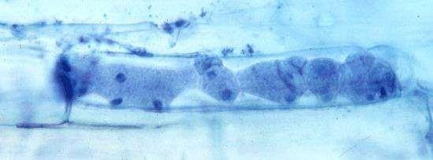
Polymyxa graminis: the vector of several cereal viruses including e.g.
Bymovirus Benyvirus,, Furovirus, Pecluvirus and Pomovirus

Slide 42

BIMODAL TRANSMISSION
While aphid transmit non-circulative viruses either in non-persistent or semi- persistent manner
Few viruses have been known to be transmitted in both the manners
This typical mode of transmission was first referred as bimodal transmission by Chalfant and Chapman (1962) in case of CaMV by M. persicae and B. brassicae.

Slide 43

SEED TRANSMISSION
Seed transmission occurs in two ways
Externally seed borne
due to external contamination of the seed with virus particles (TMV, PVX)
Internally seed borne (BCMV, CMV, BYMV, ULCV)
due to infection of the living tissues of the embryo.
Virus may be found in different parts of the seed but generally in embryonic tissues
The embryo become infected by two routes
Directly from mother plant
By pollens
Developing embryo can be infected before fertilization by the infection of the gametes or by direct invasion of the embryo after fertilization
Virus moves through the testa of immature seed after fertilization and reach micropylar region for embryo infection to occur. Micropyle is in close contact with the base of embryonic suspensor that help in nutrient flow to embryo.

Slide 44

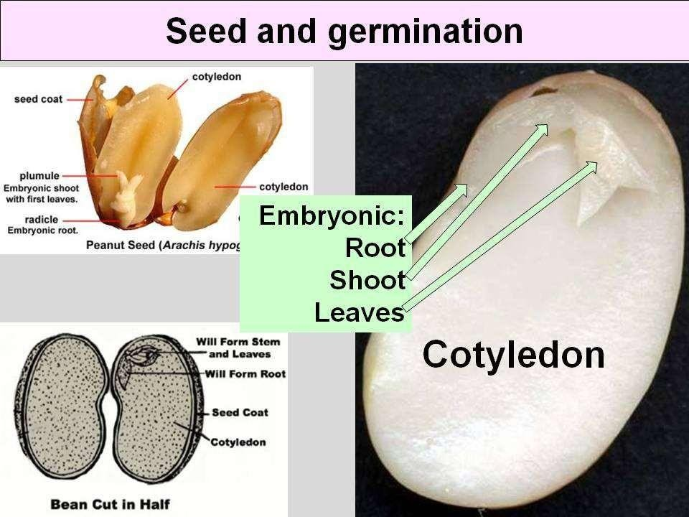
DISTRIBUTION
The virus is distributed at random and can be found in different parts of seed
Embryo; BCMV, CpMv, TRSV
Endosperm: BSMV
Seed coat: BCMV, TMV, TSWV

Slide 45


